Slide 1


Slide 2
Bento provides a platform for users to document inspiration that they see on a daily basis, and be reminded to come back to it and act on it.

Slide 3
Problem:
creative inspiration is scarce. when we forget about things in the world or moments that inspire us, we’re frustrated and our creative process is hindered
Solution:
Bento is a just-in-time solution that helps you actively record your life for moments or pieces that inspire you, and then prompts you to come back and act on this creative inspiration later

Slide 4
Tasks
Simple
setting a reminder for an inspiration entry
Medium
scrolling through a journal of inspiration
Complex
creating an inspiration entry

Slide 5
Frame:
Heuristic Evaluation
Design Changes
Prototype Implementation

Slide 6
Heuristic Evaluation:
27 total violations
5 severe violations
primarily user control

Slide 7
Heuristic Evaluation:
Takeaway 1:
need to be able to delete content/reverse parts of the content creation process

Slide 8
Heuristic Evaluation:
Takeaway 2:
difficult to exit out of canvas/content creation; header bars didn’t do good job of showing status

Slide 9
Heuristic Evaluation:
Takeaway 3:
reminders are unintuitive because we abstracted too much away; should allow user to see what kind of reminder is getting set

Slide 10
Frame:
Heuristic Evaluation
Design Changes
Prototype Implementation

Slide 11
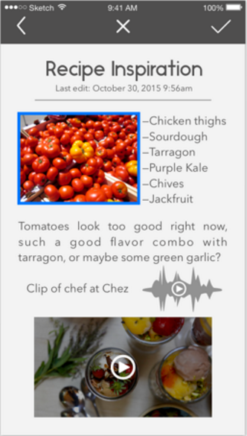
Design Changes
Alteration 1:
X to delete selected asset

Slide 12
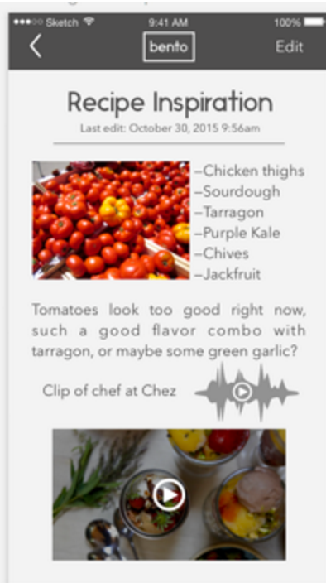
Design Changes
Alteration 2:
Back button/updated header bars added

Slide 13
Frame:
Heuristic Evaluation
Design Changes
Prototype Implementation

Slide 14
Prototype Implementation
currently, we have implemented the simple task (scrolling through past entries) in iOS in Objective-C
However:
we are looking to switch to Ionic, which has much better support for the movement of our elements

Slide 15
Prototype Implementation
todos:
possibly convert everything to Ionic
redesign reminder setting process
finish tasks 1 and 3

Slide 16
Prototype Implementation
the plan is to redo task 2 (scrolling) in Ionic by Wednesday, and over next weekend build out task 3 (adding/editing entries), finishing task 1 (setting of reminders) by next Friday; task 1 also needs to be redesigned, which hopefully will also be done by next Wednesday

Slide 17
Prototype Implementation
“Wizard of Oz” - system automatically knowing what kind of reminder to set based on entry; will probably just always choose time in this case
Starting Data - all hardcoded

Slide 18
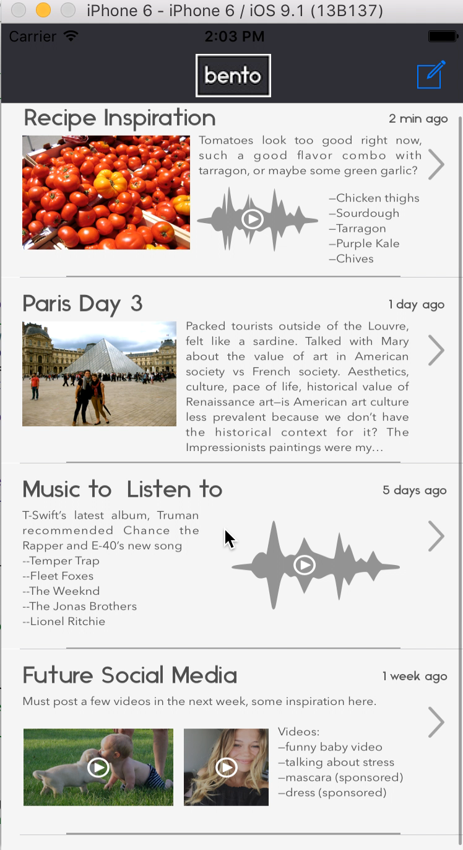

Slide 19
Prototype Implementation
Building a prototype is hard.
Might need to switch to Ionic.
Getting first task up involves a lot of framework and groundwork that might need to be replicated.
Design changes revolved around system status and reversal.

